Slide 1
Md. Imrul Kayes ID: 21MCSE010P M.Sc. In CSE Chittagong University of Engineering and Technology (CUET)
CSE 6310 Data Science and Analytics

Slide 2


COVID-Index: A Texture-Based Approach To Classifying Lung Lesions Based On CT Images Vitória de Carvalho Brito, Patrick Ryan Sales dos Santos , Nonato Rodrigues de Sales Carvalho, AntonioOseas de Carvalho Filho
Journal: Pattern Recognition (Volume 119, November 2021, 108083) https://doi.org/10.1016/j.patcog.2021.108083

Slide 3

Outline
Introduction
Related Works
Problem Statement
Objective
Dataset overview
Proposed Method
Result Analysis
Discussion

Slide 4
Introduction
COVID-19 is an infectious disease caused by a type of coronavirus called SARS-CoV-2.
A of April 2021, the number of confirmed cases of COVID-19 reported to the World Health Organization has already exceeded 135 million worldwide, while the number of deaths exceeds 2.9 million.
This work proposes the application of texture descriptors based on phylogenetic relationships between species to characterize segmented CT volumes, and the subsequent classification of regions into COVID-19, solid lesions and healthy tissue.

Slide 5
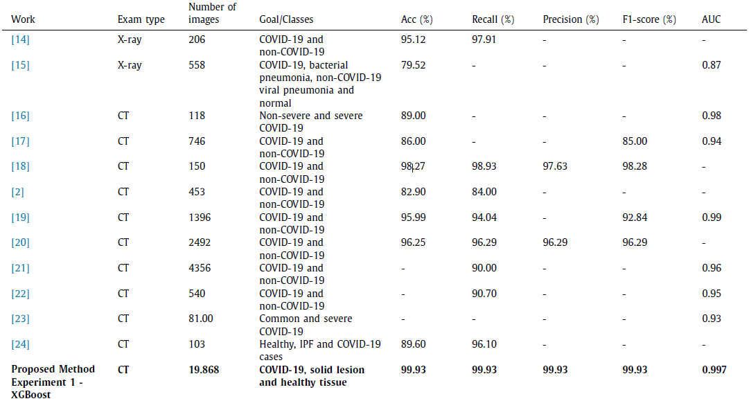
Related Works

Slide 6
Problem Statement
Despite the application of various CNN-based methods to image classification, in which a CNN is responsible for extracting and selecting representative features in its convolutional layers, these feature maps are not always efficient enough to allow for classification.
The authors of previous studies proposed the use of transfer learning. In addition, the training of a CNN requires considerable time in order to create a capable model, and several tests of architectures and parameters are required. Powerful machines are also needed to run these networks.
Therefore, In this paper, the authors use phylogenetic diversity indexes for the feature extraction task of COVID-19, solid lesions and healthy tissue, in conjunction with the random forest and extreme gradient boost (XgBoost) classifiers.

Slide 7
Objective
Create a phylogenetic and taxonomic diversity index to characterise image textures.
Improve the efficiency of the index calculation by optimizing the phylogenetic tree assembly.
Present a method that can be applied in patient triage and therefore assist in efficiently managing healthcare systems.
A system that can diagnose patients quickly, especially when the medical system is overloaded.
Reduce the burden on radiologists and assist underdeveloped areas in making an accurate and early diagnosis.

Slide 8
Dataset Overview
Authors have utilise images from three different datasets to evaluate our approach.
Dataset | Diagnosis | Number of images
LIDC | Solid Lesions | 1679
 | Healthy tissue | 17742
COVID-19 (1) | GGO, Consolidation and pleural effusion | 215
COVID-19 (2) | GGO, Consolidation and pleural effusion | 274

Slide 9
Proposed Method 1. Feature Extraction 2. Classification 3. Visual Representation Of The Proposed Method 4. Experiments

Slide 10
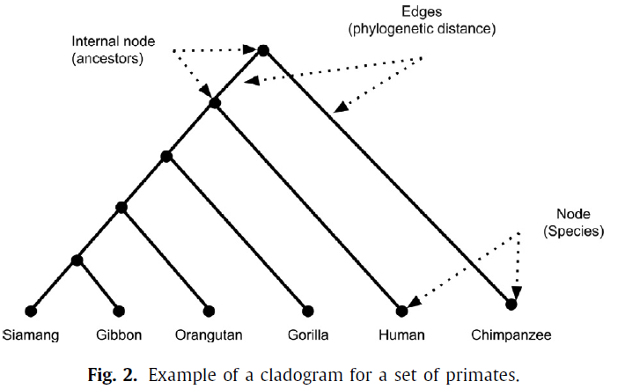
Phylogenetic Diversity Indexes
1. Feature Extraction
In phylogenetic trees, leaves represent species and nodes represent common ancestors. The phylogenetic tree used in this work is called a cladogram.

Slide 11
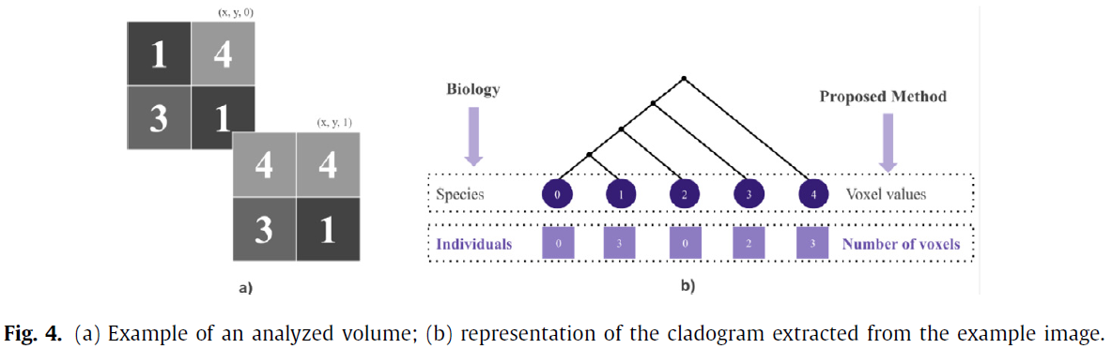
1. Feature Extraction (Phylogenetic Diversity Indexes)
Authors generate a cladogram for each study image.

Slide 12








1. Feature Extraction (Phylogenetic Diversity Indexes)
Phylogenetic Diversity (PD)
Sum of Phylogenetic Distances (SPD)
Mean Nearest Neighbour Distance (MNND)
Phylogenetic Species Variability (PSV)
Phylogenetic Species Richness (PSR)
Mean Phylogenetic Distance (MPD)
Taxonomic Diversity Index (△)
Taxonomic Distinction Index (△*)
The proposed indexes are computed by applying the relevant equations from the cladogram. Each index represents a specific feature of the image, so we use eight indexes (i.e., eight features) to represent each image.

Slide 13
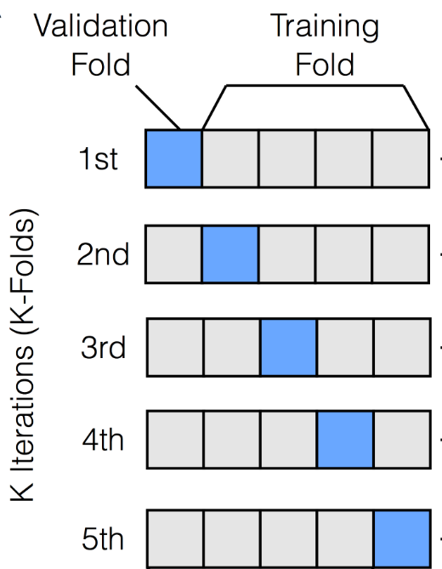
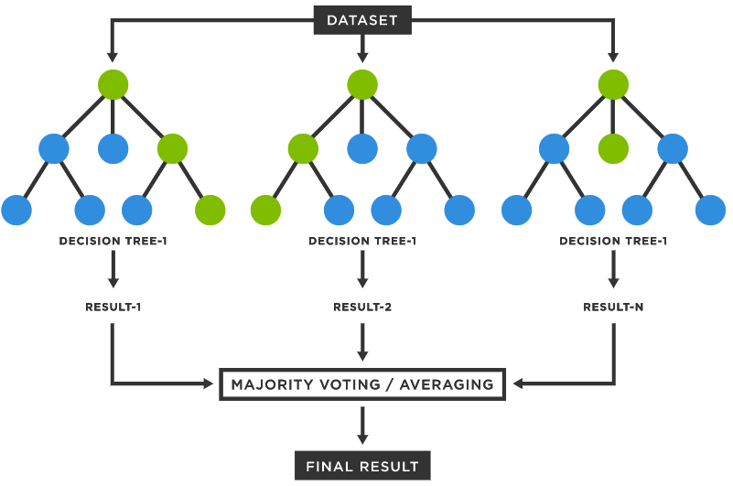
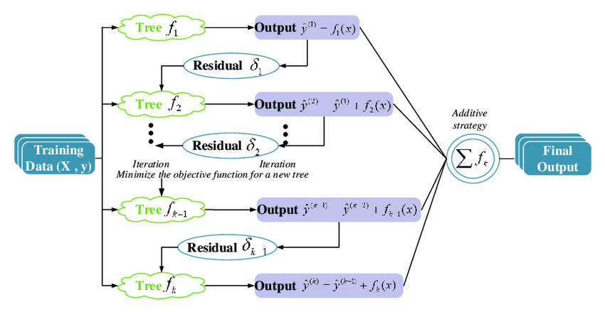
2. Classification
Random Forest (RF)
Extrema Gradient Boost
K-Fold Crossvalidation

Slide 14
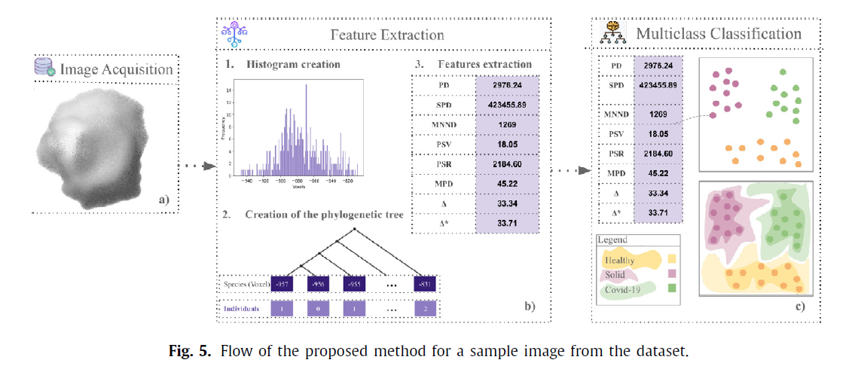
3. Visual Representation Of The Proposed Method

Slide 15
4. Experiments
Experiment | Description/classes | Number of images
1. | Healthy tissue × Solid × COVID-19 (1) × COVID-19 (2) | 19.868
2. | Healthy tissue × Solid × COVID-19 (1) | 19.624
3. | Healthy tissue × Solid × COVID-19 (2) | 19.653

Slide 16
Result Analysis 1. Validation Metrics 2. Results of the Proposed Method 3. Comparison With Other Descriptors 4. Result Analysis

Slide 17
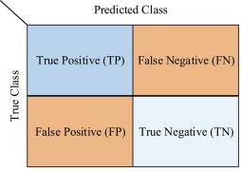
1. Validation Metrics
To evaluate the classification models obtained in the proposed method, the authors used the following metrics:
Accuracy
Recall
Precision
F1- score
AUC.
To calculate these metrics, Authors analyze the confusion matrix, which is constructed based on four values:
True Positive (TP)
False Positive (FP)
False Negative (FN)
True Negative (TN).

Slide 18
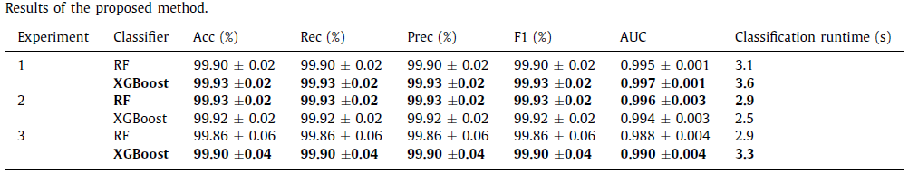
2. Results of the Proposed Method

Slide 19
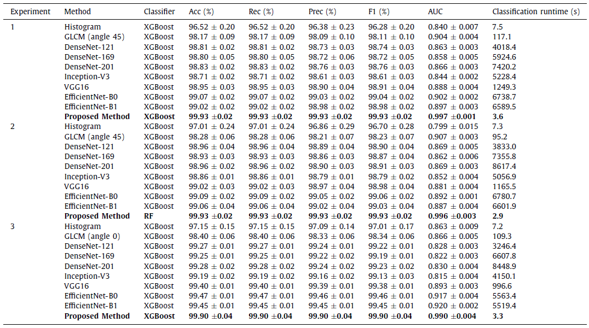
3. Comparison With Other Descriptors

Slide 20
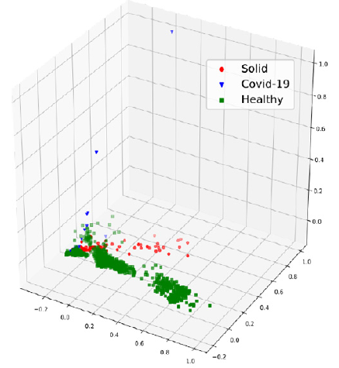
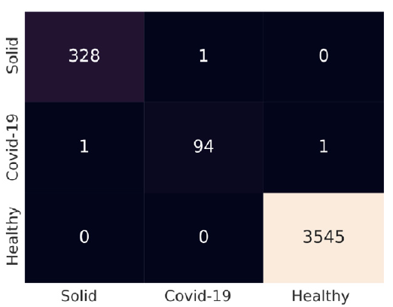
4. Result Analysis
Picture Component Analysis With Three Components Representation
Confusion Matrix of Result

Slide 21
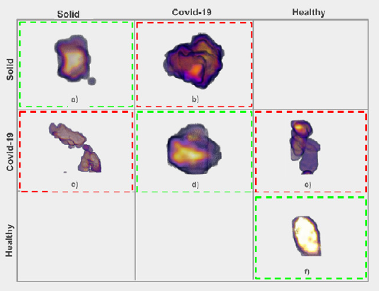
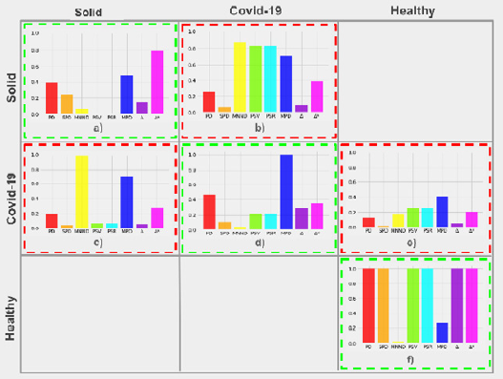
4. Result Analysis
Confusion Matrix With Correct And incorrect Classification Regions
Graphs Of The Indexes Extracted from The Images In The Images In The Confusion Matrix

Slide 22
Discussion 1. Limitations 2. Conclusion 3. Future Work

Slide 23
Limitations Of The Proposed Methodology
Images with large differences between the higher and lower voxel intensities may require a longer time for the calculation of the indexes.
Note: A voxel is a unit of graphic information that defines a point in three-dimensional space. Since a pixel (picture element) defines a point in two-dimensional space with its X and Y coordinates, a third z coordinate is needed. In 3-D space, each of the coordinates is defined in terms of its position, color, and density.

Slide 24
Conclusion
The phylogenetic diversity indexes adopted in this work, when used with the XGBoost classifier, showed the best efficiency in terms of the characterization and classification of lung lesions, and yielded promising results in all of the experiments that were performed.
The results were promising and consistent in all test scenarios and with all of the classifiers used, motivating the application of descriptors proposed in real environments;
Of all the works considered here, the set of images used with this method was the most extensive; this is important, because it showed that the proposed descriptors achieved good results, even on a wide variety of images.

Slide 25
Future Work
Use other sets of COVID-19 images to improve the effectiveness of the prediction method.
Explore the use of image sets that include other types of lesions from patients with COVID-19, such as multifocal solid lesion irregular nodules and nodules with visible halo signs.
Adapt this method for the classification of COVID-19 variants.

Slide 26

The End

Slide 27


